Slide 1


VOYAGER
Welcome to our Tourism Management Software Presentation …

Slide 2




Brains of the Project
Sudipta Kumar Das (20-43658-2)
Riya Basak Risha (20-43317-1)
Aamir Mohammed Zobayer (20-44193-2)
Md. Najmus Shakib Khasru Parvez (20-43548-1)

Slide 3

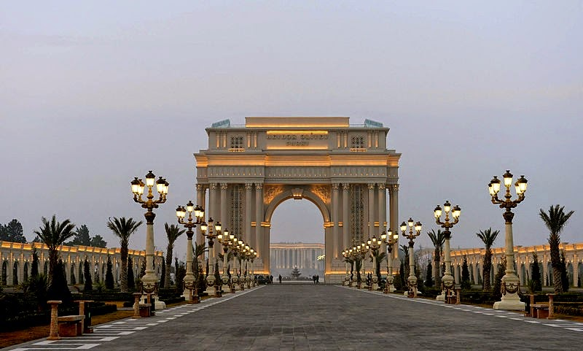

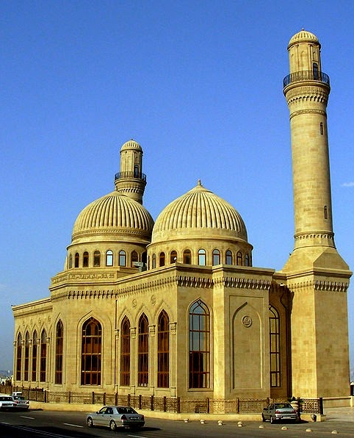
What is Voyager?
Voyager is an advanced Tourism Management System Developed for Businesses that give Tourism Booking Services. The main scope of the developers of this software during developing this was to make something unique and more user-friendly software for businesses to make their profit.

Slide 4
Who will Get the Most out of it?
Voyager is Developed to make life easier for those Entrepreneurs and Business Companies related to the tourism booking business. The Software is very user-friendly and feature-resourceful that, the companies can easily implement this tech and increase the efficiency of their business to its limits!

Slide 5


USERS
THERE WILL BE 6 USERS
Admin
Manager
Receptionist
Broker
Affiliate
Staff

Slide 6
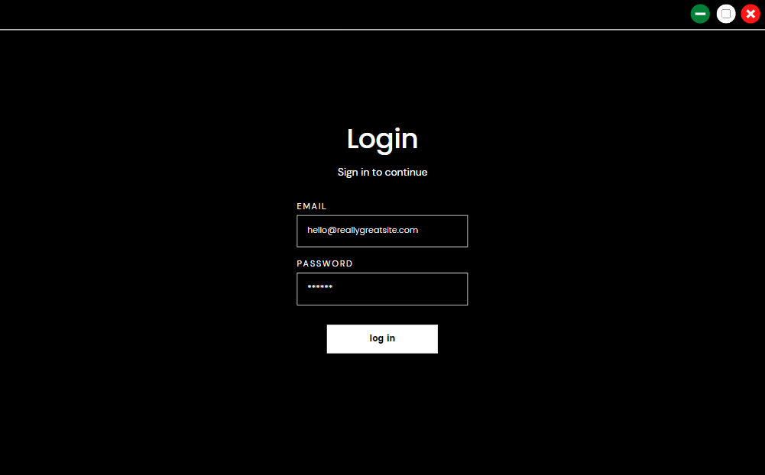
Login page
The Login page will be a simple minimal signing system where user can enter ID and Password to get into the system. Admins will be redirected to admin panel and receptionist will be to their respective pages.

Slide 7
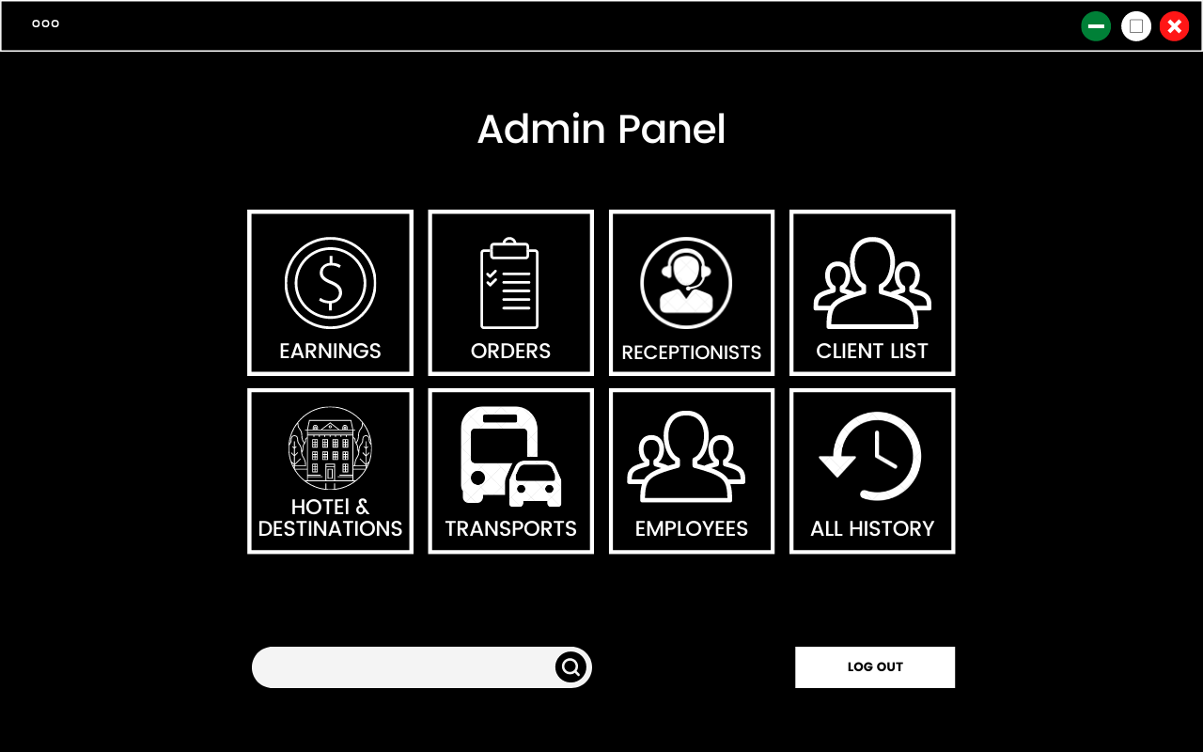
Admin Page
Admin panel includes multiple functions that includes:
To see earnings
See Tours
List of Receptionists
Client's list
Hotel’s list that are available for booking
Transports lists.
All available destinations
And all transaction history
There is also a Search System Added.

Slide 8
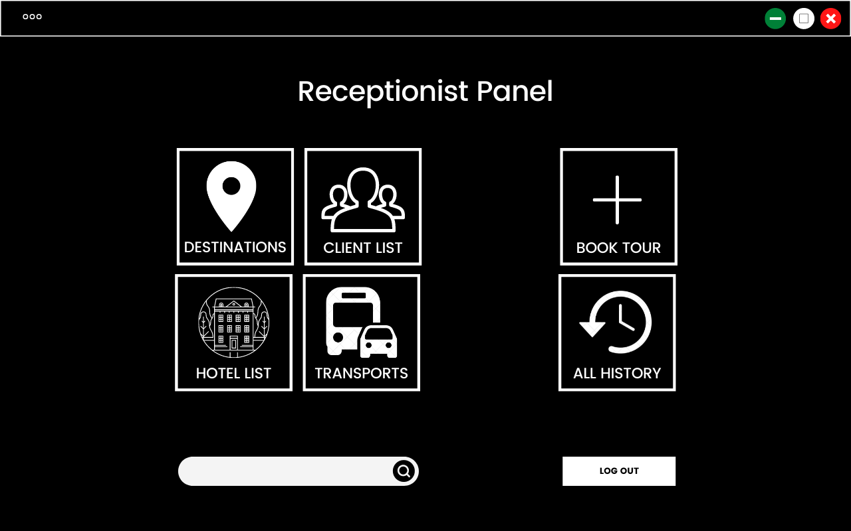
THE RECEPTIONIST PANEL
The Receptionist panel is for the receptionists who will take the orders from customers. This panel includes some same stuff from admin panel. In Addition, here the receptionist can book customer orders by the “Book Order” button.

Slide 9
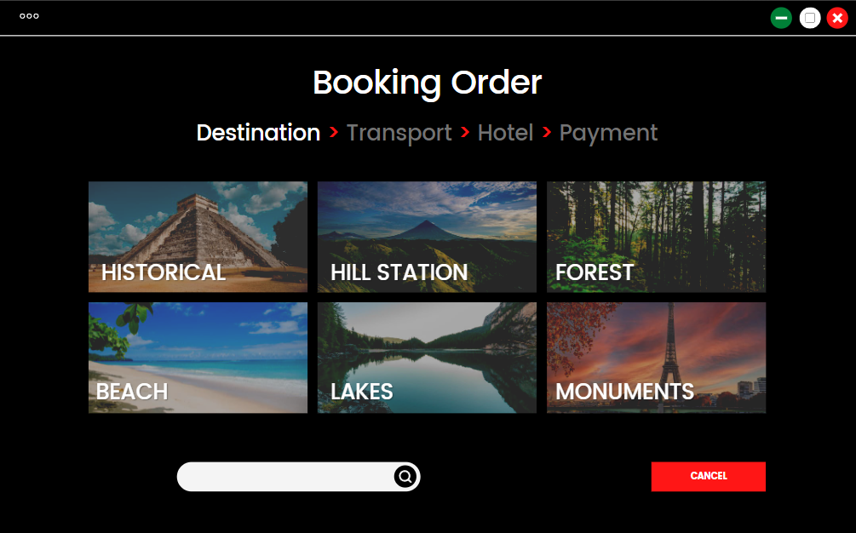
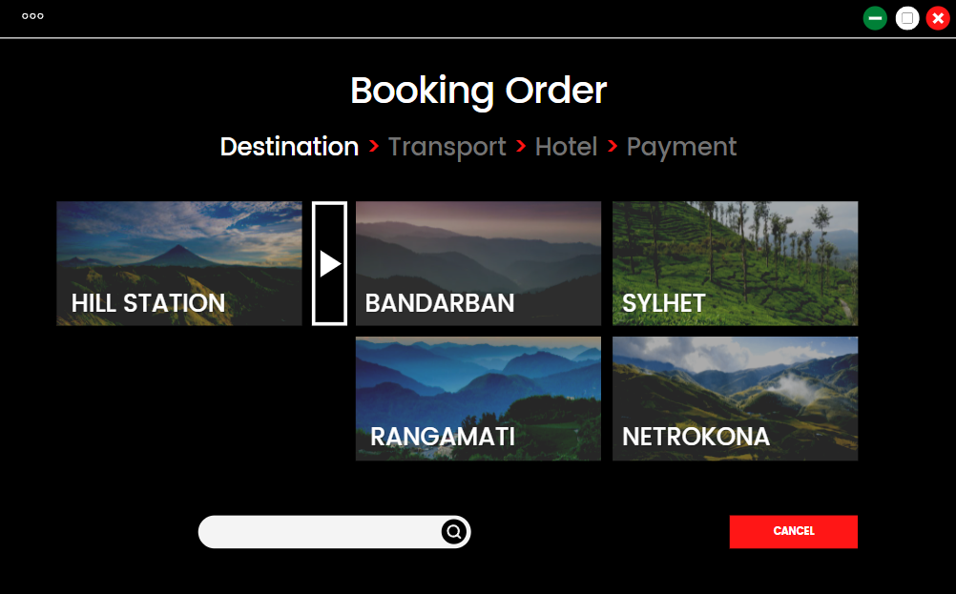
BOOKING SYSTEM#1
Booking will be done in some stages. In The First stage The Destinations will be shown category wise.

Slide 10
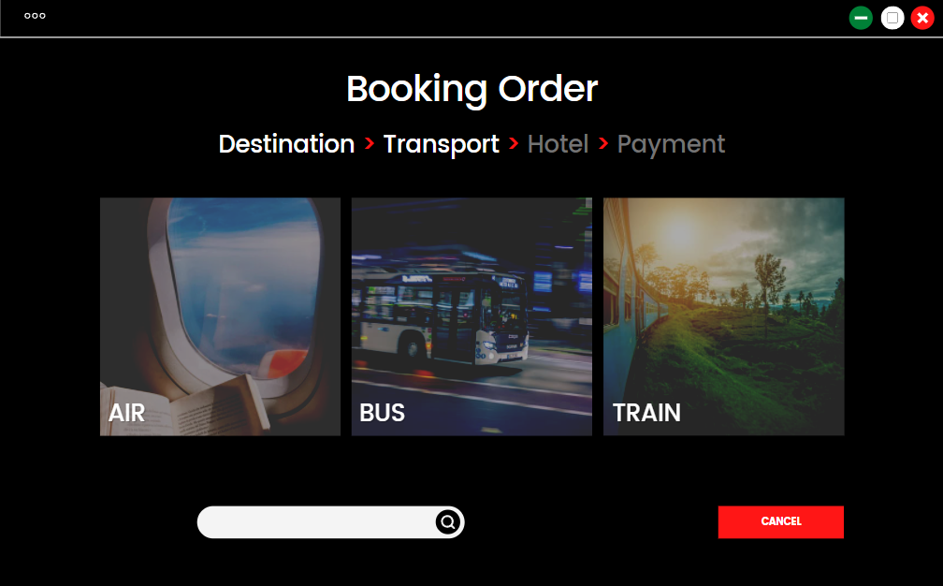
BOOKING SYSTEM#2
In the second stage the Transports will be selected. After selection a price placement will be show that will be visible in next stage.

Slide 11
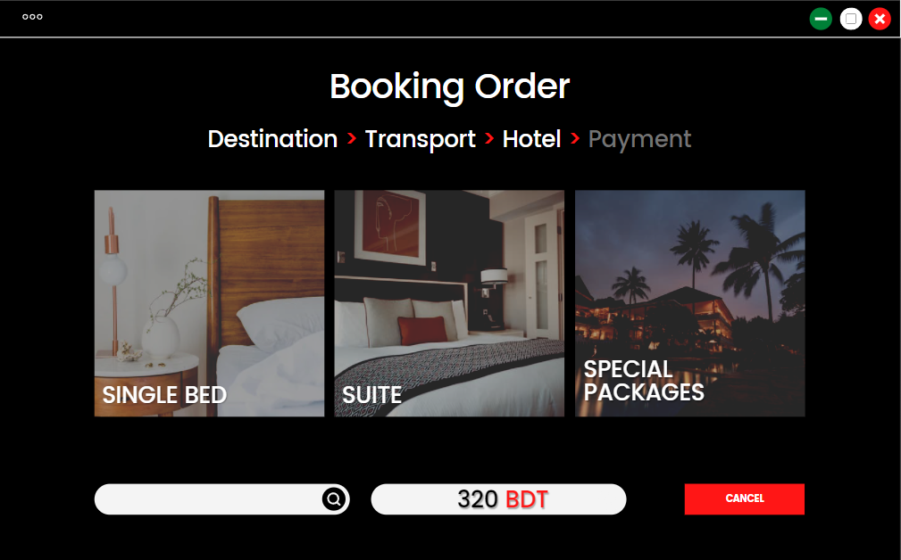
BOOKING SYSTEM#3
In This stage hotel suits will be selected. Along with this the total price will be updated.

Slide 12
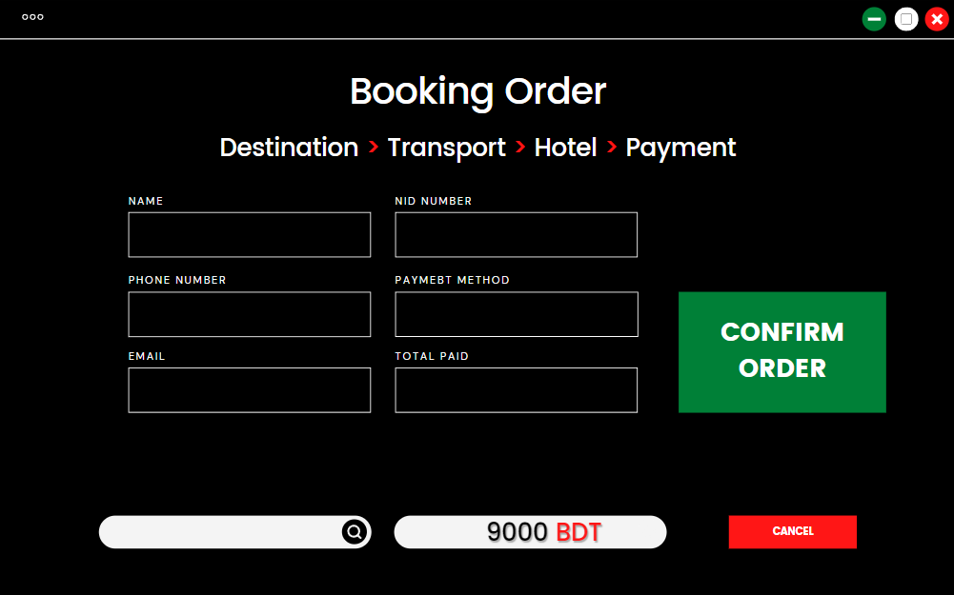
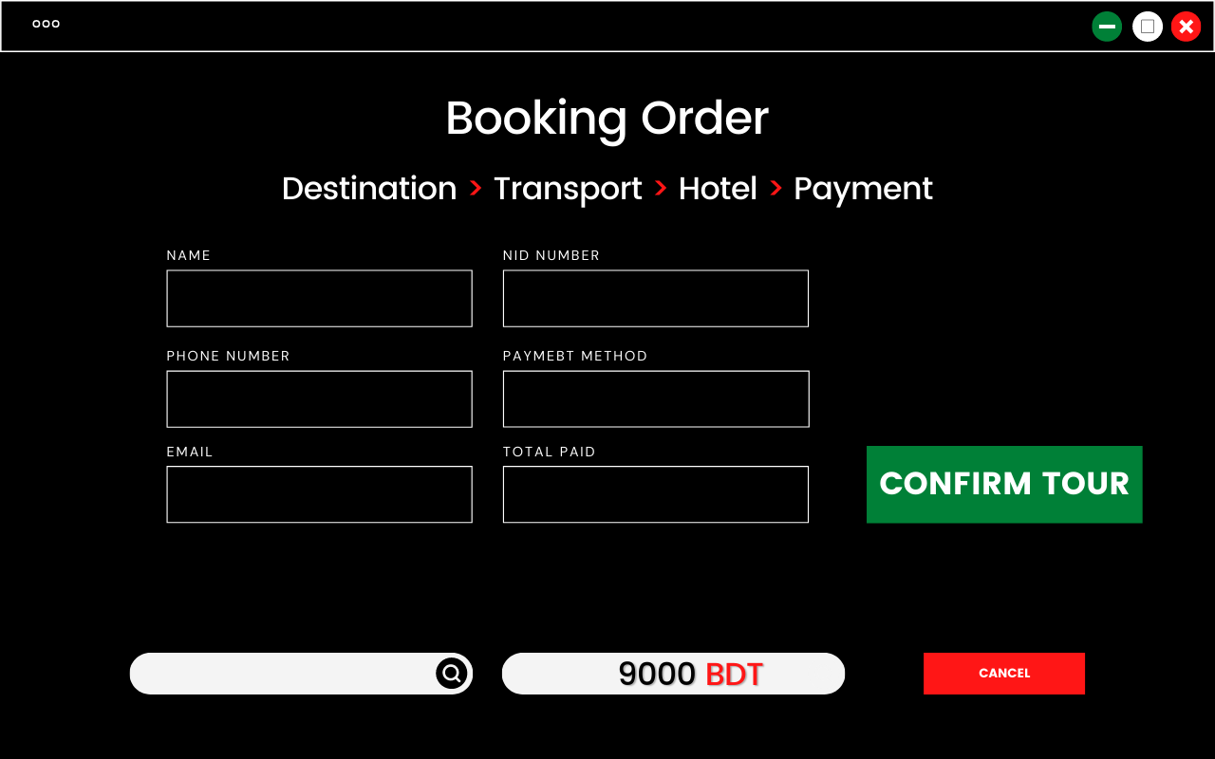
BOOKING SYSTEM#4
This is payment section where the Order will be confirmed via payment.

Slide 13
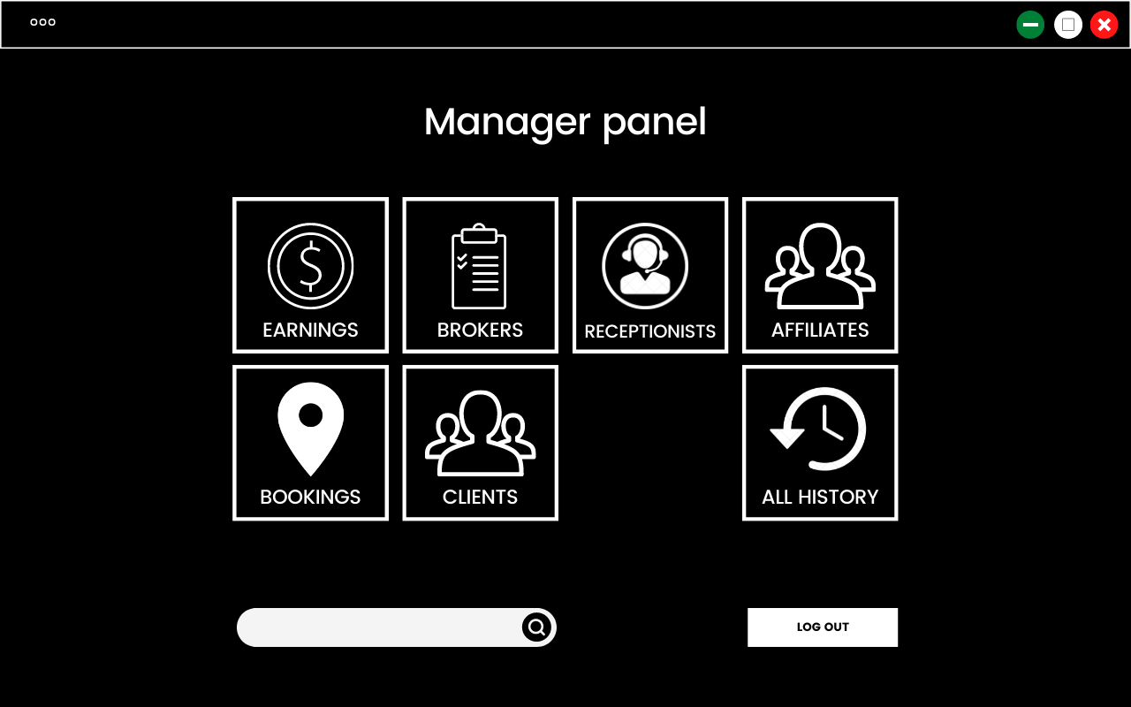
Manager Panel
This portal is for the manager who will in charge of managing the whoe system.
This system will like Admin panel almost but not admin panel.

Slide 14
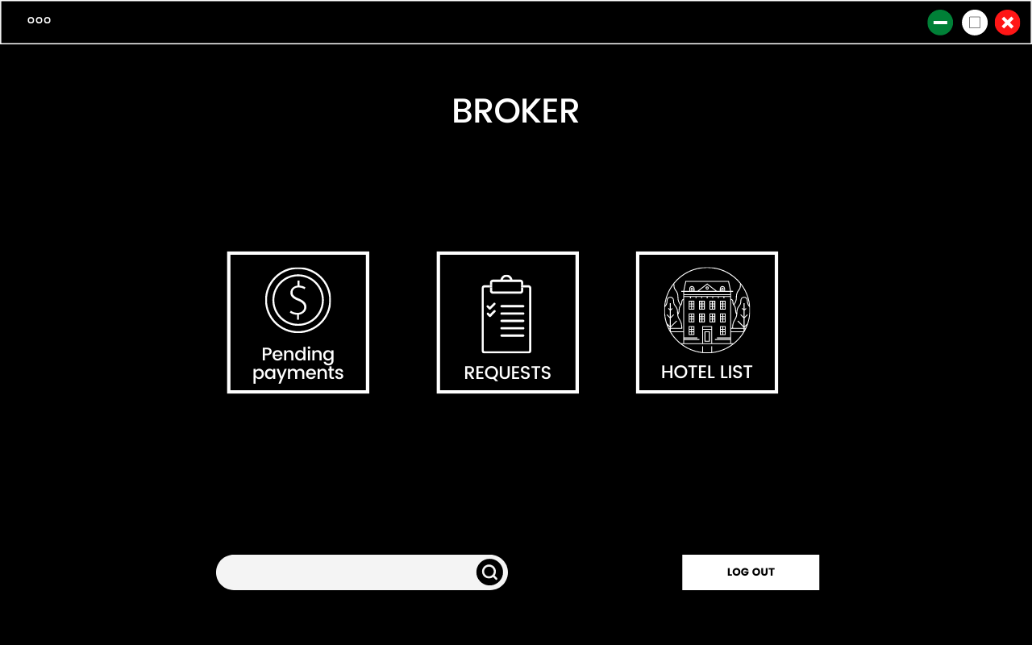
BROKER
This is for the Brokers who will manage the deals with hotels and tourist Spots.

Slide 15
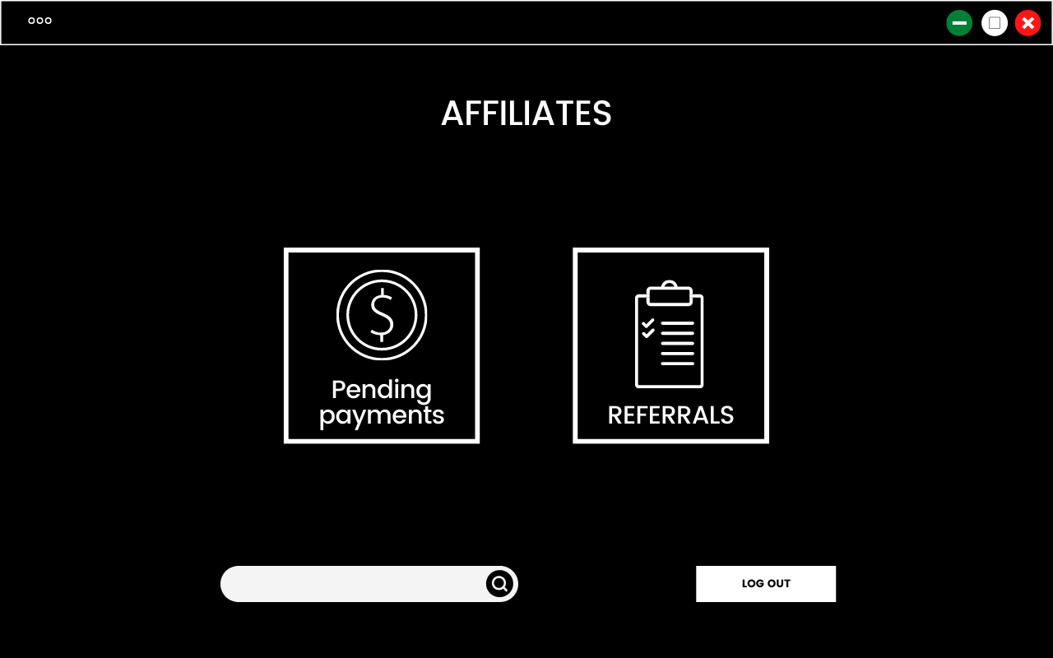
AFFILIATES
This is for the Affiliates who will do referrals jobs.

Slide 16

STAFF
This is basic staff portal for all other minor management staff.

Slide 17
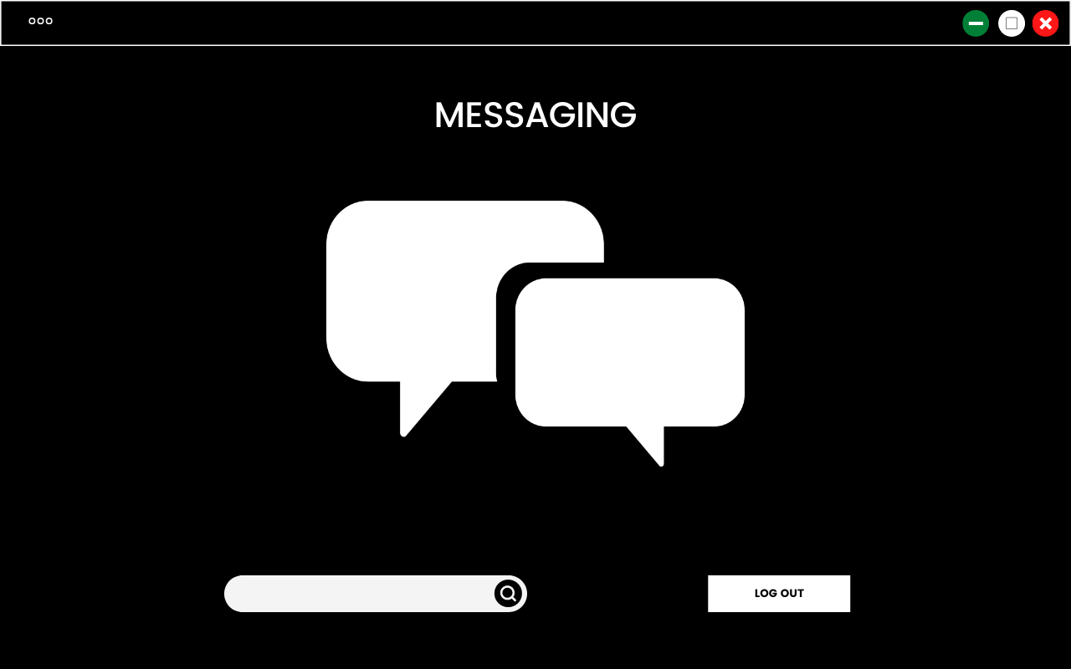
BONUS FEATURE!
Messaging feature within company bounds. For Local communication purposes.

Slide 18
FUTURE PROSPECTS
This software can increase the productivity and attractiveness of Tourism Management companies specially start-ups. As very user-friendly UI, this project can be sold to those Entrepreneurs. And also have more scope to Further Updates!

Slide 19
THANK YOU
FACULTY : ARGHO DAS

